Slide 1

Dynatrce on Azure
Modernize and Monitor Applications with Dynatrace on Azure

Slide 2


Jay Gurbani, Sr Partner Solutions Architect at Dynatrace
Peter Laudati, Principal Cloud Solution Architect at Microsoft

Slide 3
What Is What The Hack ?
“What the Hack” is a challenge-based hackathon format
Challenges describe high-level tasks and goals to be accomplished
Challenges are not step-by-step labs.
By having to “figure it out”, attendee knowledge retention is greater
Attendees work in squads of 3 to 5 people to solve the challenges
Attendees “learn from” and “share with” each other.
Coaches provide technical guidance, but not answers to the squads
Coaches may provide lectures & demos to setup challenges & review solutions
What the Hack can be hosted in-person or virtually via Microsoft Teams

Slide 4
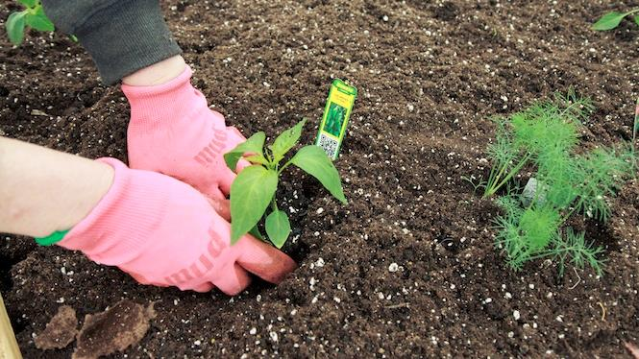
You will get your hands dirty
Notes:
This is a “hands-on” exercise where you will work in groups of 4-5 people to solve technical challenges.
You only get out what you put in, don't be lazy.
Knowledge Retention is achieved through Pain and Discomfort

Slide 5
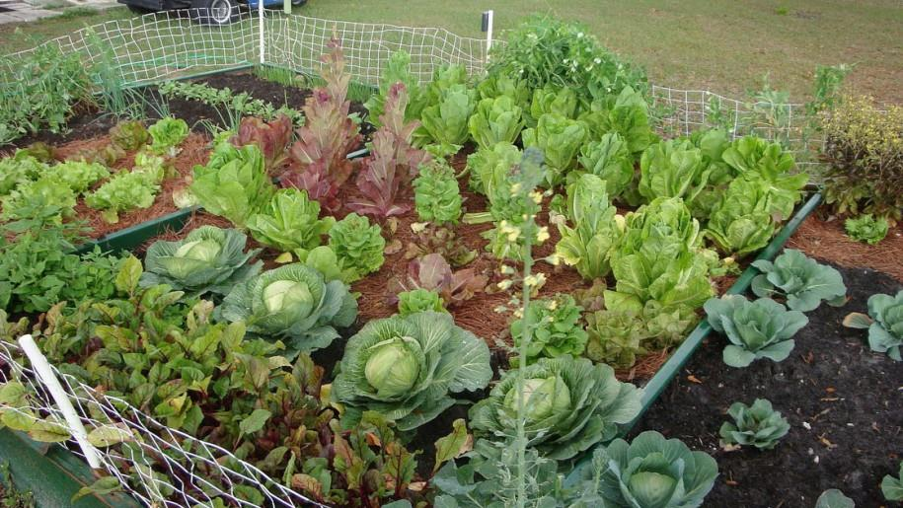
*results may vary
Notes:
You might not grow a garden like this… but at least you can learn while trying.

Slide 6

Challenge Format
Challenges are cumulative, building upon each other.
Establish Confidence – start small and simple (think hello world)
Build Competence – by having successively more complex challenges
Challenges are NOT step-by-step hands-on labs!
No “clicking here” or “copy n pasting there”
Challenge definitions are short. A couple of sentences or bullet points stating the end goal(s) and perhaps a hint at the skill(s) needed.
You MUST work together as a team to figure out how to complete them!

Slide 7

Coaches
Each team will have a coach through-out the whole hack.
Use them! But don’t expect them to give you all the answers.
Get to know your coach, their likes and dislikes...
All the better to find a bribe that works!

Slide 8

Tooling
You can use any tooling you want, but we strongly encourage (and will only support the following):
Azure Cloud Shell

Slide 9

Finding Answers
Search engines are your friend! Azure is a hot technology and much ink has been spilled on it.
The Azure and Dynatrace docs are your best bet.
Many of the related open source projects used here have top notch documentation!

Slide 10
Challenge 0

Slide 12
Challenge 1

Slide 15
Challenge 2

Slide 18
Challenge 3

Slide 21
Challenge 4

Slide 24
Challenge 5

